Slide 1
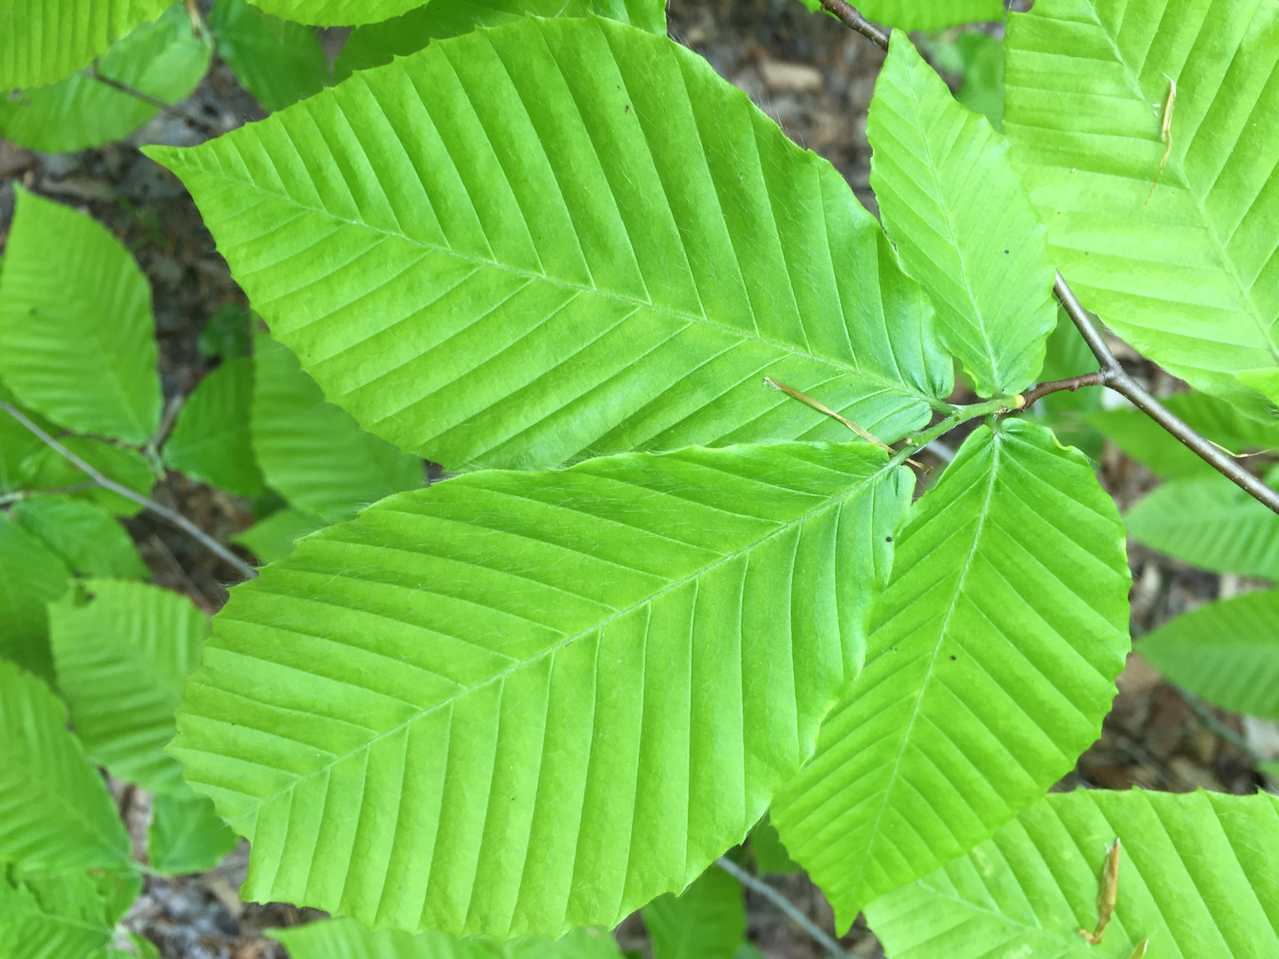


Rethinking False Spring
Catherine Chamberlain
Arnold Arboretum | Harvard University

Slide 2
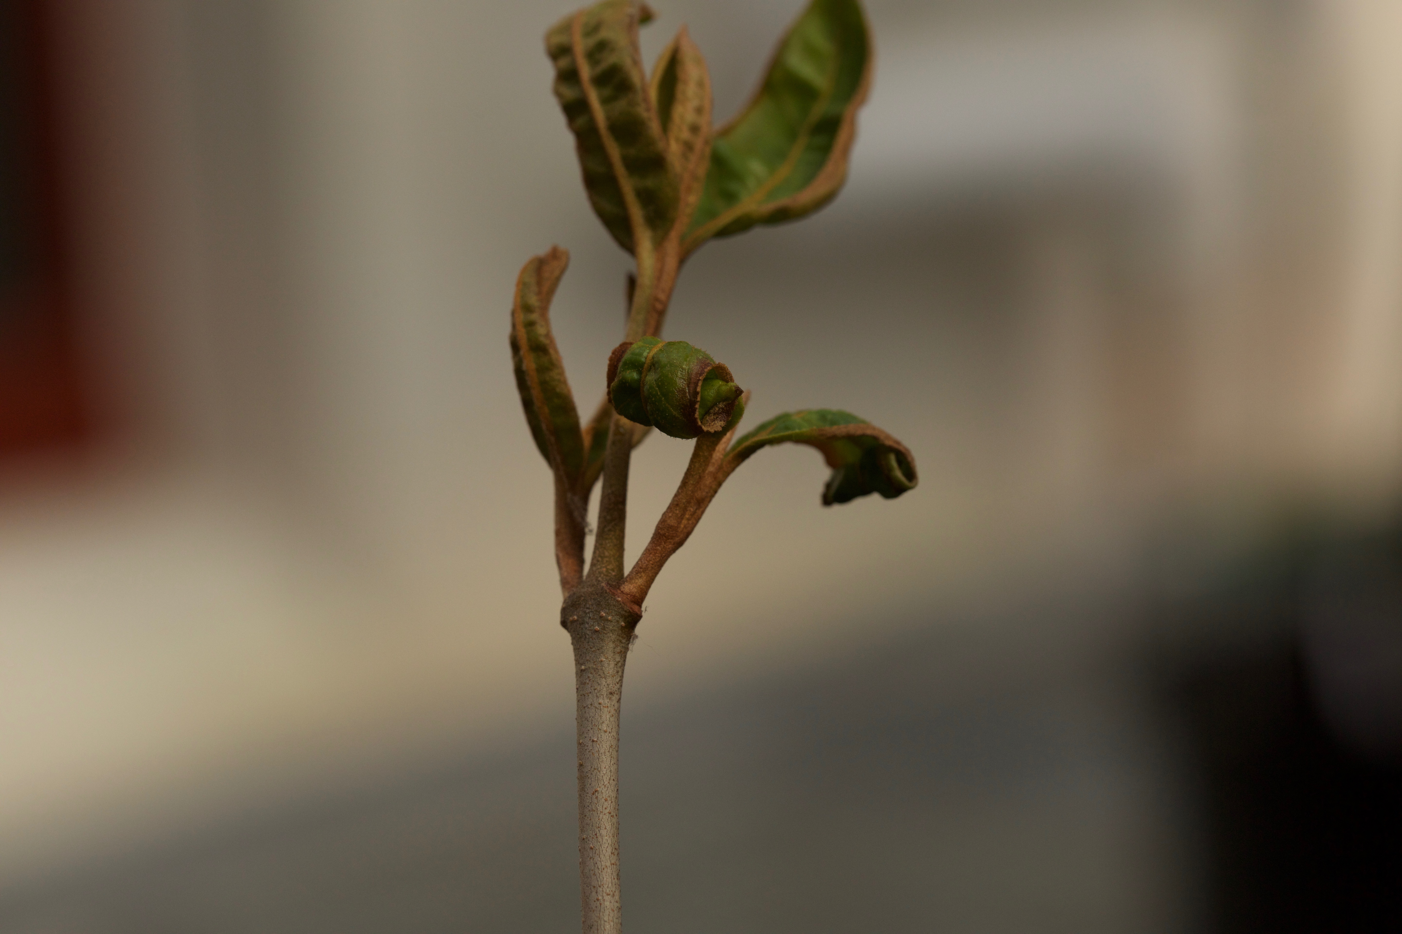
OUTLINE
Introduce Concept of False Spring
Explain Duration of Vegetative Risk
Some Results
Future Directions

Slide 3
DEFINITION
False Spring: freezing temperatures AFTER budburst has initiated
There are two phases involved in a false spring:
Rapid vegetative growth prior to the freeze
Post freeze setback
Gu et al, 2008

Slide 4
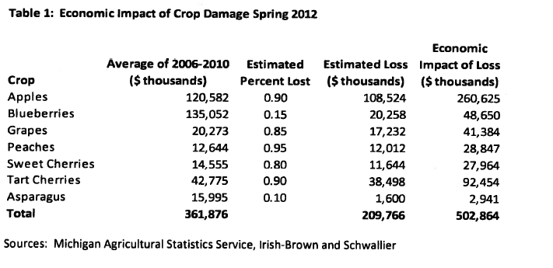
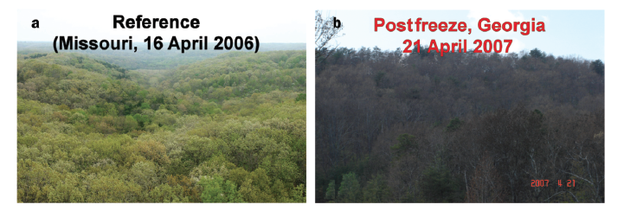
MASSIVE ECONOMIC AND ECOLOGICAL CONSEQUENCES.
Knudson, 2012
Gu et al, 2008

Slide 5
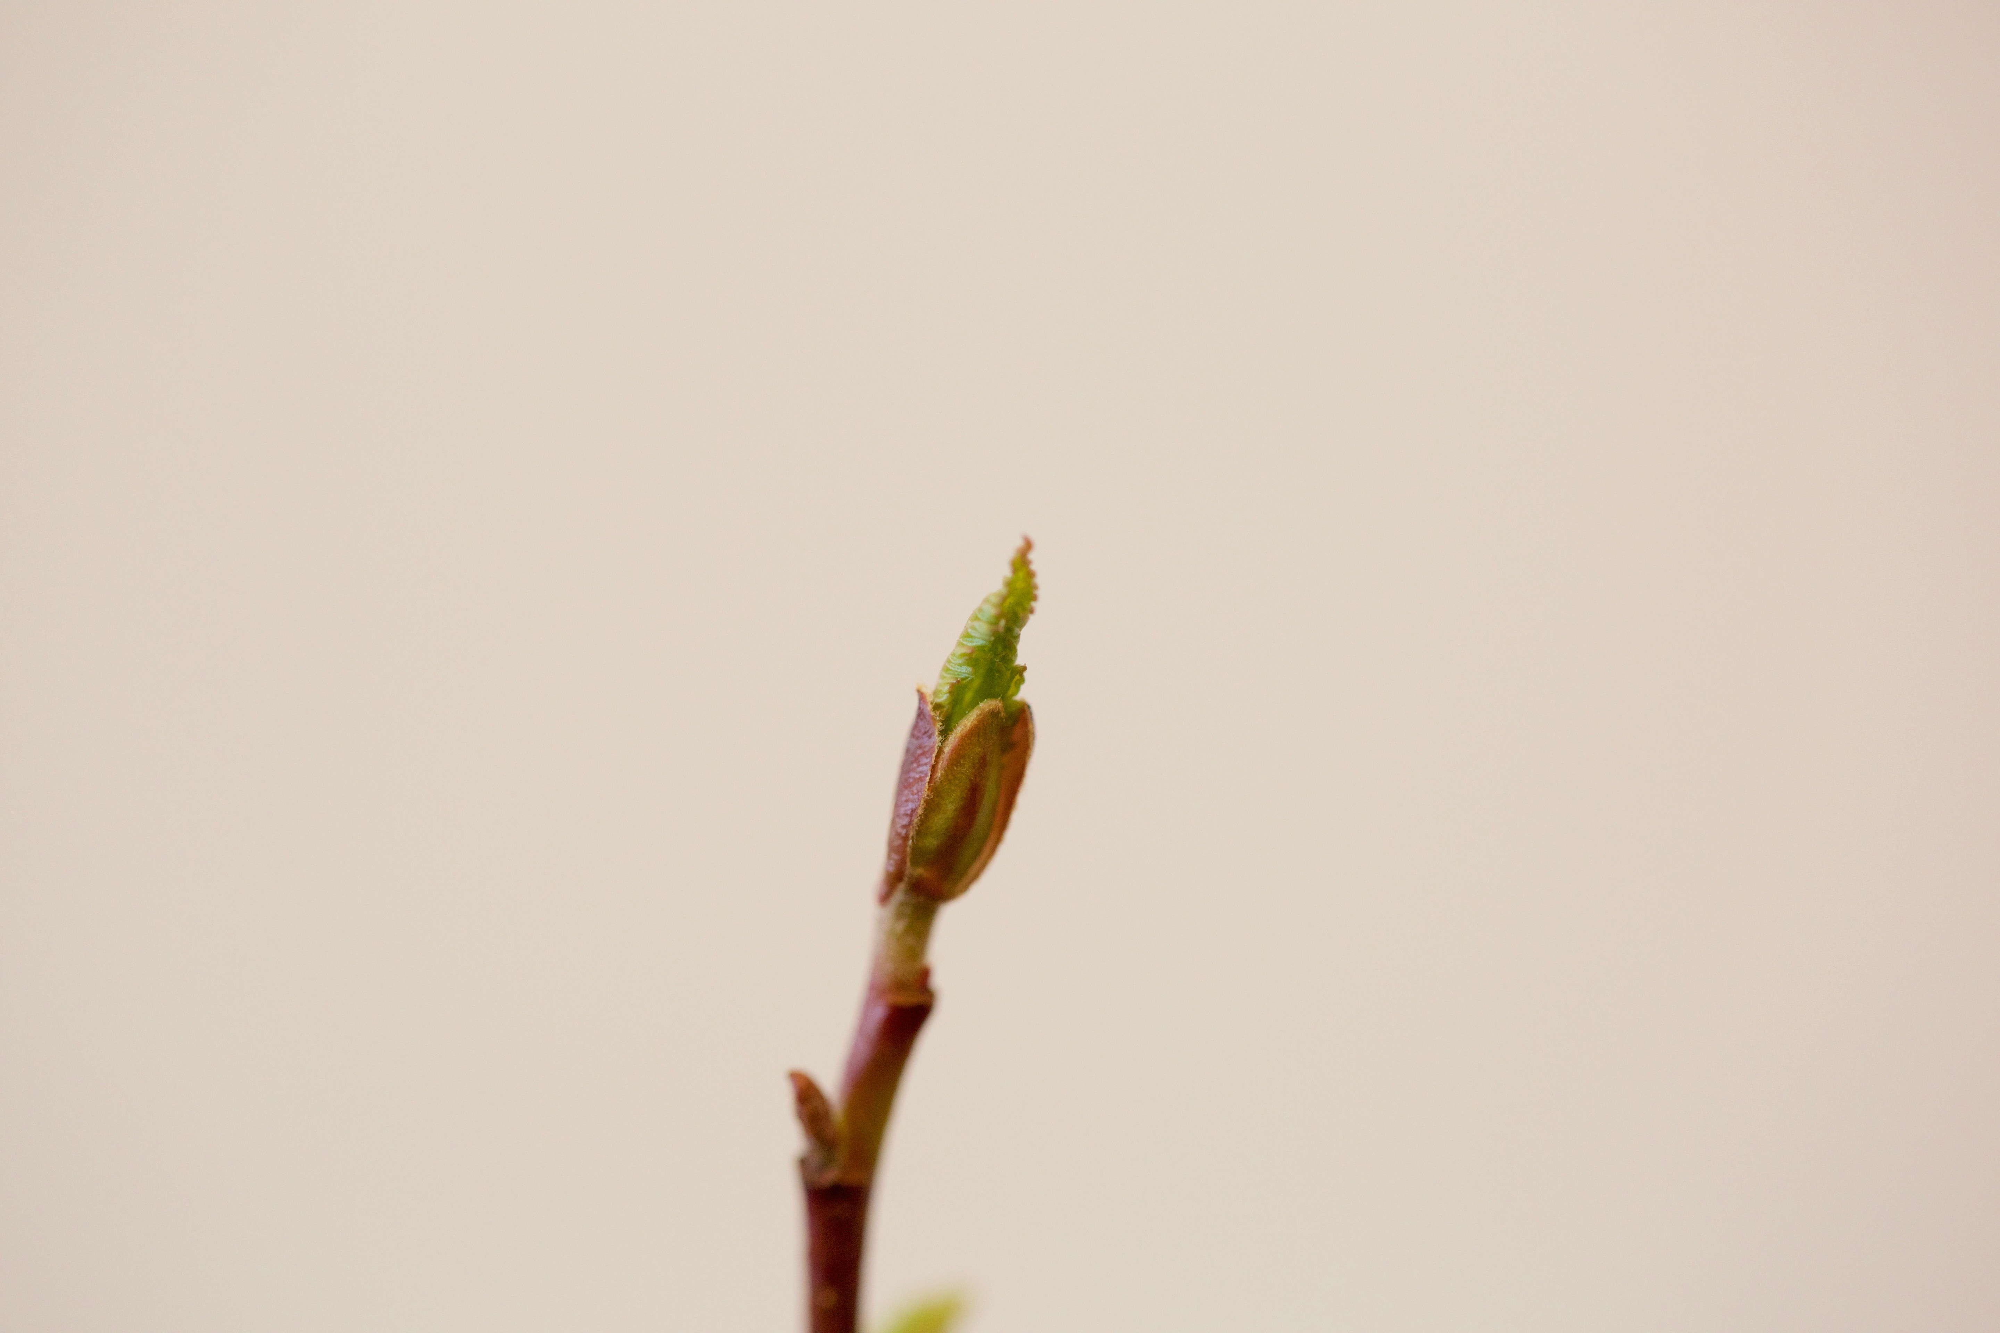
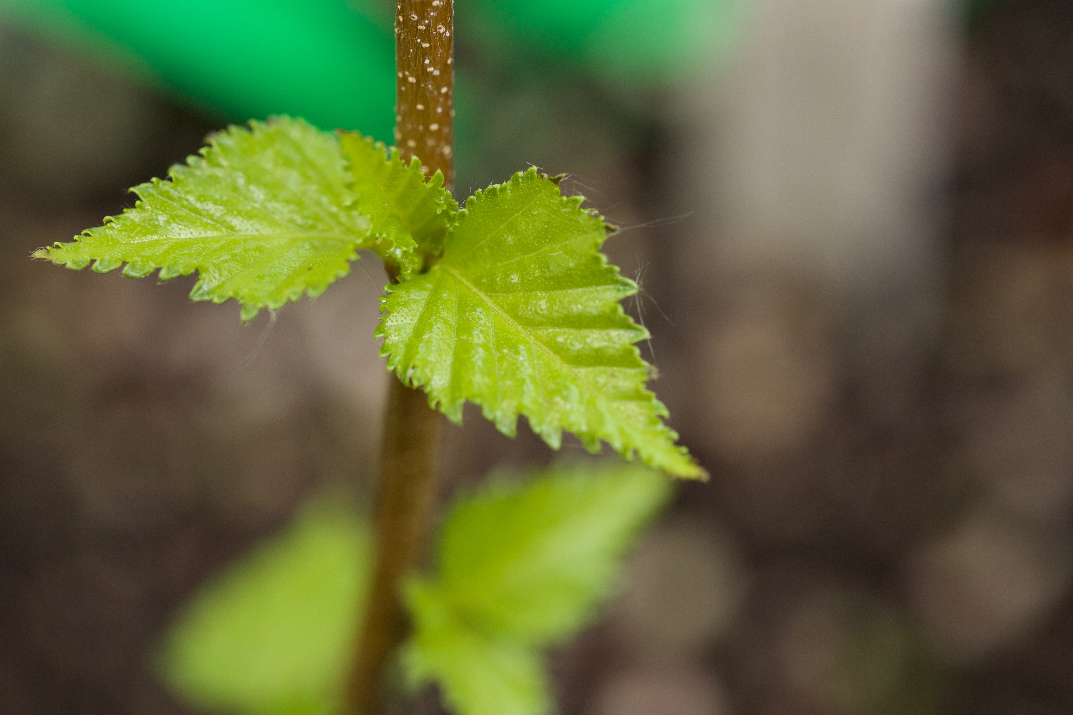
Alnus incana - budburst
False Spring Risk
With anthropogenic climate change, the severity of damage sustained is predicted to increase due to:
Earlier spring onset
Greater fluctuations in spring temperatures
Freezing tolerance steadily decreases after budburst begins until the leaf is fully unfolded.
Lenz et al., 2016
Betula populifolia - leafout

Slide 6
Alnus incana - budburst
False Spring Risk
Interested in time between leaf budburst and leafout
BUDBURST
LEAFOUT
DURATION OF VEGETATIVE RISK
Betula populifolia - leafout

Slide 7
Alnus incana - budburst
False Spring Risk
Most damaging false spring events occur during the Duration of Vegetative Risk
BUDBURST
LEAFOUT
FALSE SPRING
Betula populifolia - leafout

Slide 8
Calendar
OCT
NOV
DEC
JAN
FEB
MAR
APR
MAY
JUNE
Chilling
Warming
Daylength
INPUTS
Endodormancy
Ecodormancy

Slide 9
Calendar
OCT
NOV
DEC
JAN
FEB
MAR
APR
MAY
JUNE
Chilling
Warming
Daylength
INPUTS
Endodormancy
Ecodormancy
Duration of Vegetative Risk
OUTPUTS
Budburst
Leafout

Slide 10
Calendar
OCT
NOV
DEC
JAN
FEB
MAR
APR
MAY
JUNE
Chilling
Warming
Photoperiod
INPUTS
Endodormancy
Ecodormancy
Duration of Vegetative Risk
OUTPUTS
Budburst
Leafout
Likelihood
Potential
Risk
False Spring
Intensity

Slide 11
RESULTS
CSO: No extra winter chilling
Short Photoperiod
Lower spring temperatures
VS.
WL1: Extra winter chilling
Long Photoperiod
Higher spring temperatures
Very different durations of vegetative risk with early budburst species
Chilling has same affect on budburst and leafout

Slide 12
Regional Differences

Slide 13
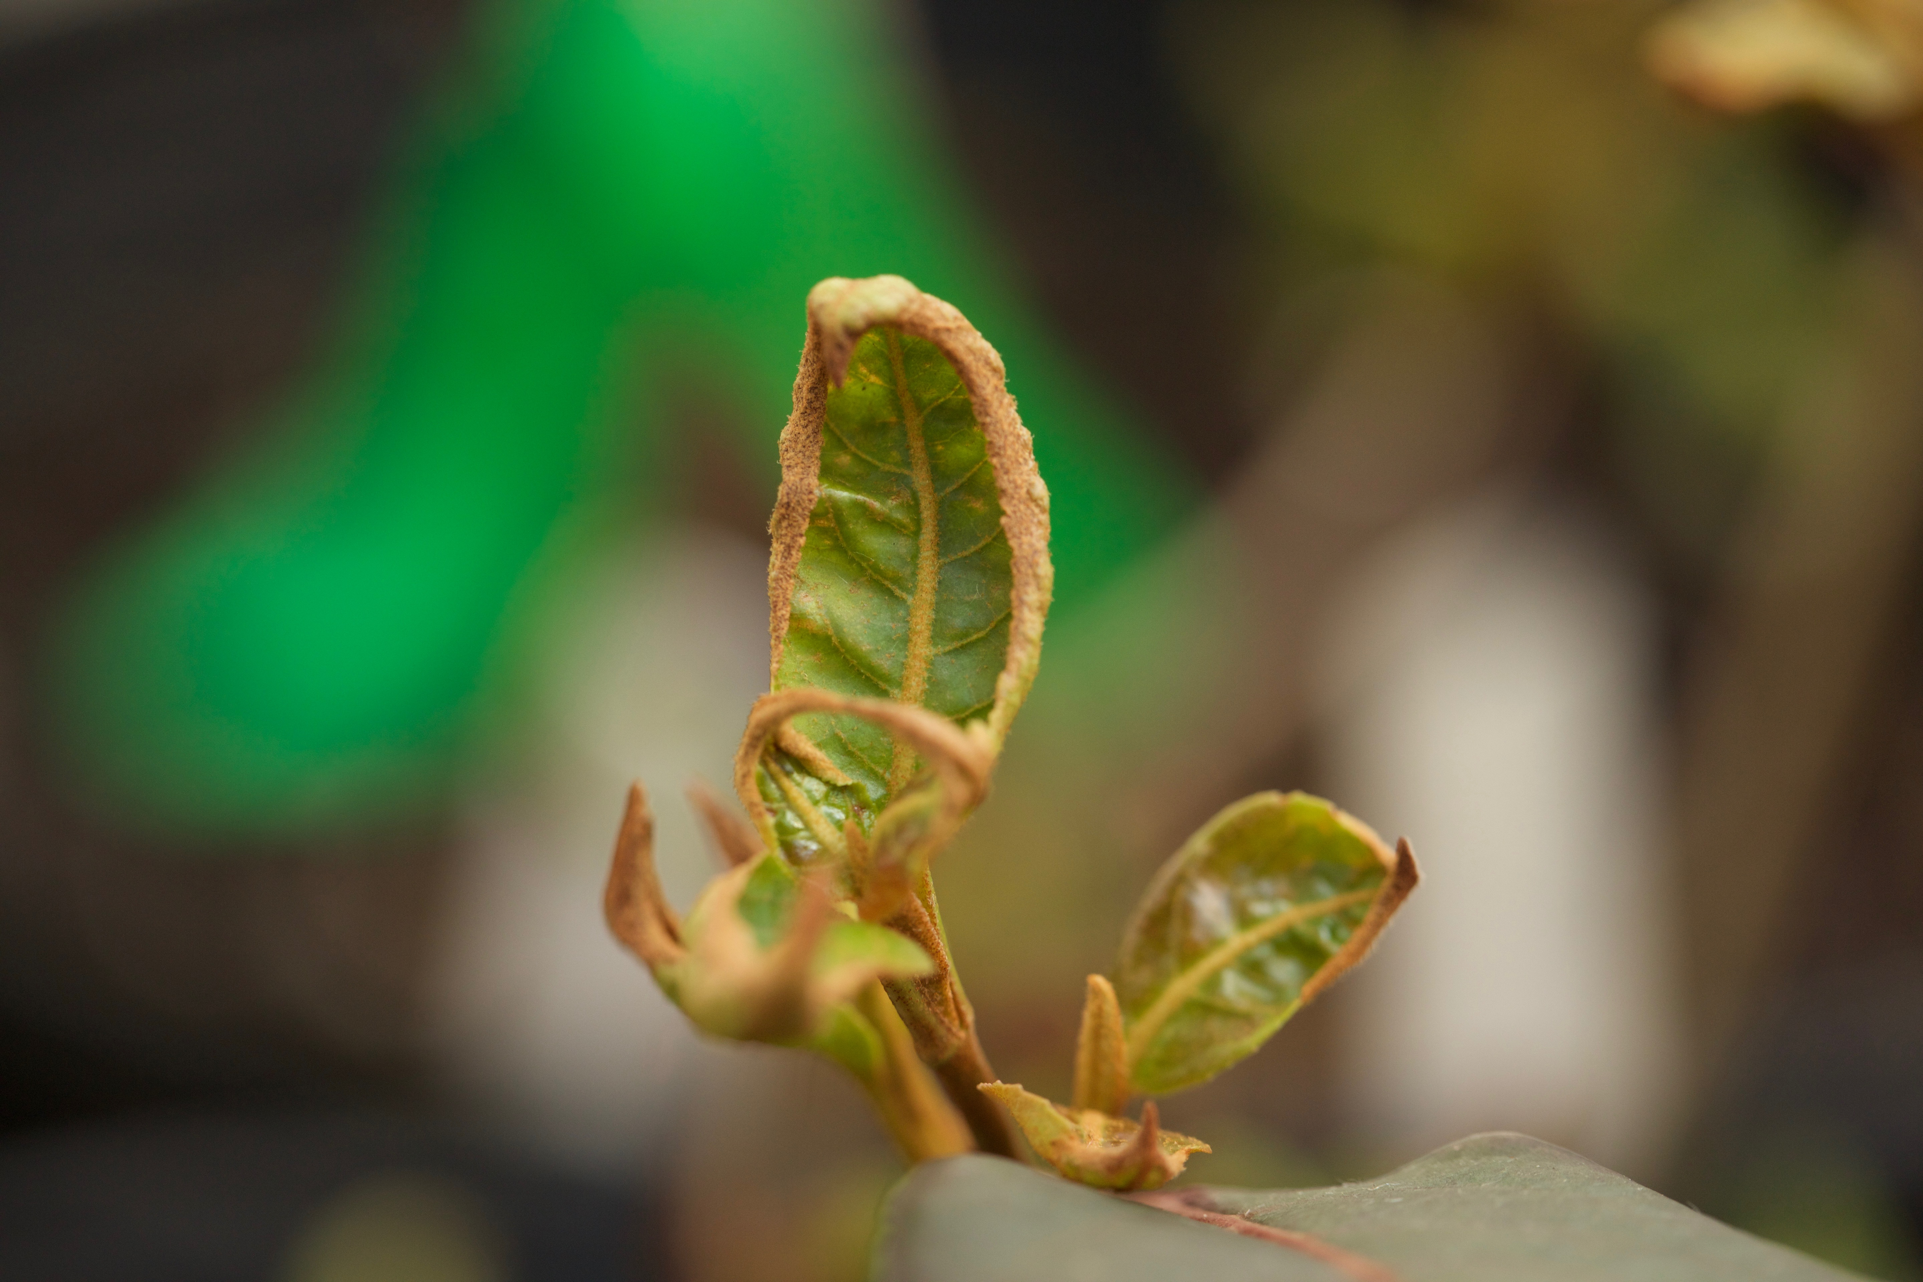
Future Directions
Freezing Experiment and Long-Term Damage:
Regional Differences and Future Projections of Risk by Species:

Slide 14
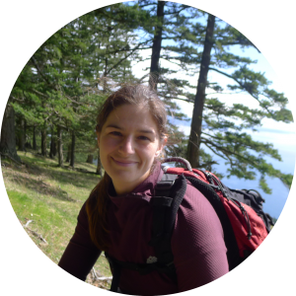
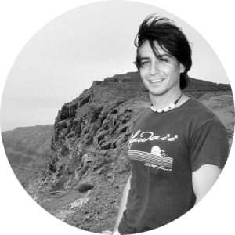
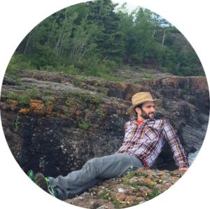
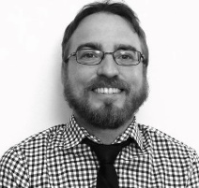
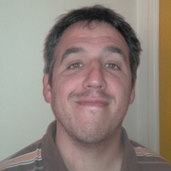
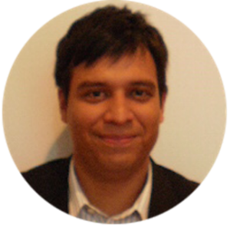
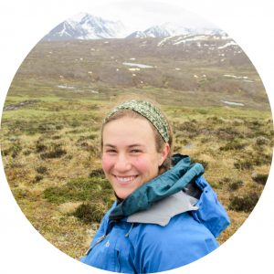
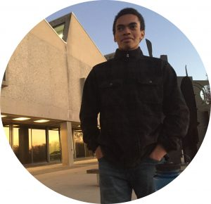
Acknowledgements
The Temporal Ecology Lab
Collaborators

